Slide 1
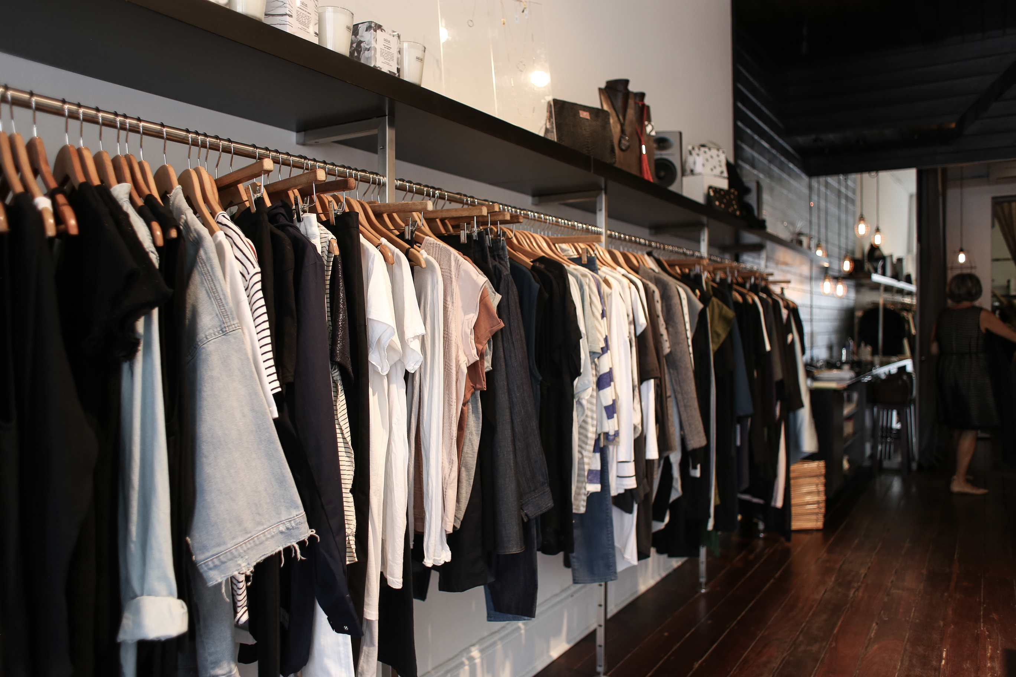

Keithston & Partners
About
Product
Project
Contact
Search
BEKA STORE
Page 01
2030

Slide 2

About
Product
Project
Contact
Search
INTRODUCTION
BEKA is an online clothing store aiming to deliver fashionable products through a digital shopping experience.
This project focuses on redesigning the BEKA website to enhance usability, visual appeal, and emotional user experience, ultimately improving customer trust and engagement
Page 02
2030

Slide 3
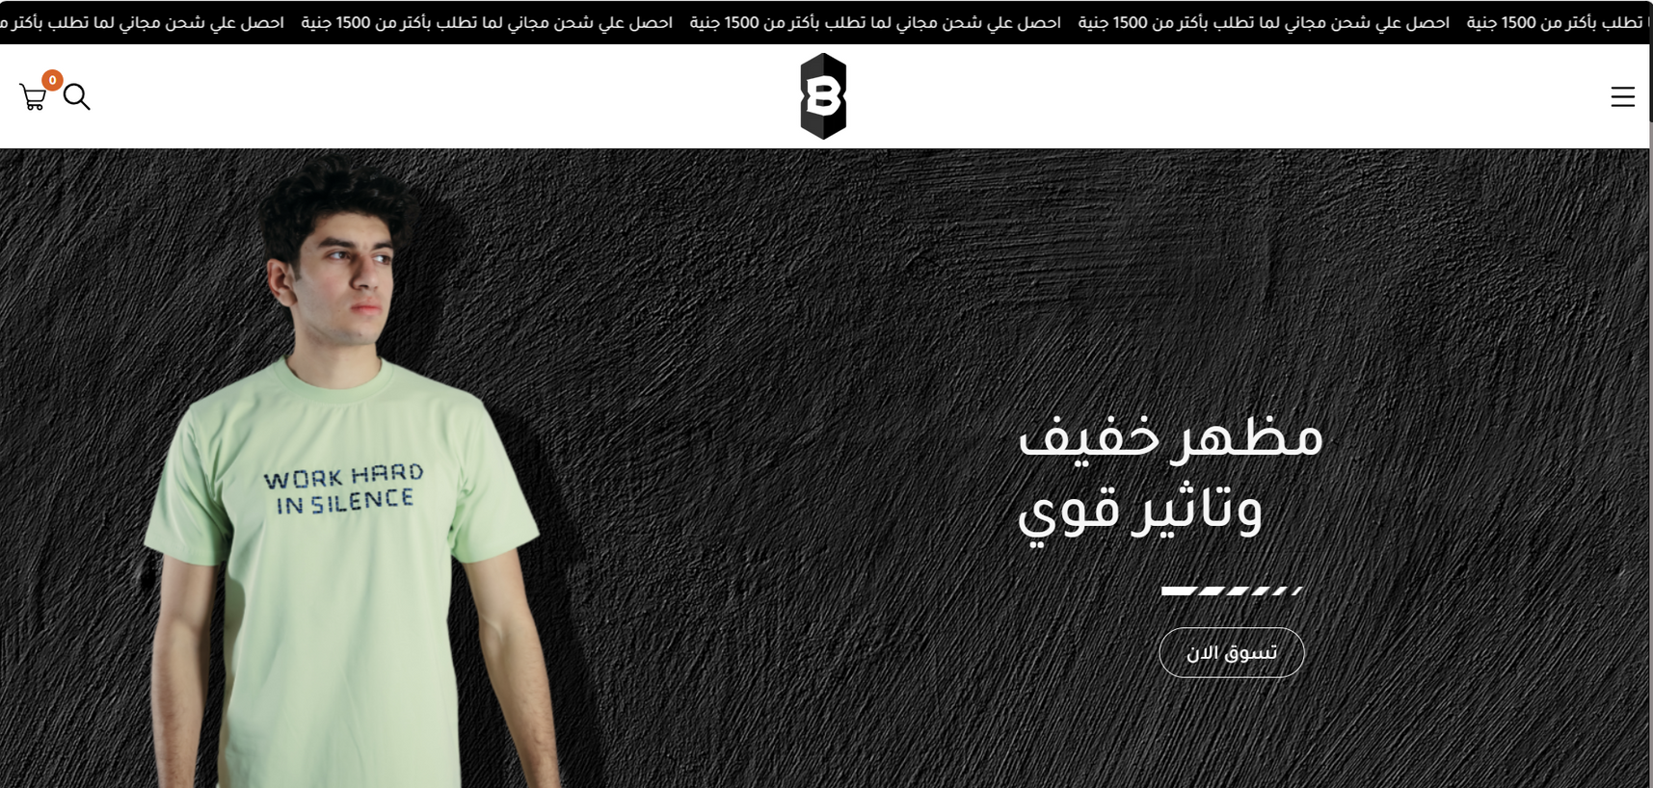
About
Product
Project
Contact
Search
OLD DESIGN
Page 03
2030

Slide 4
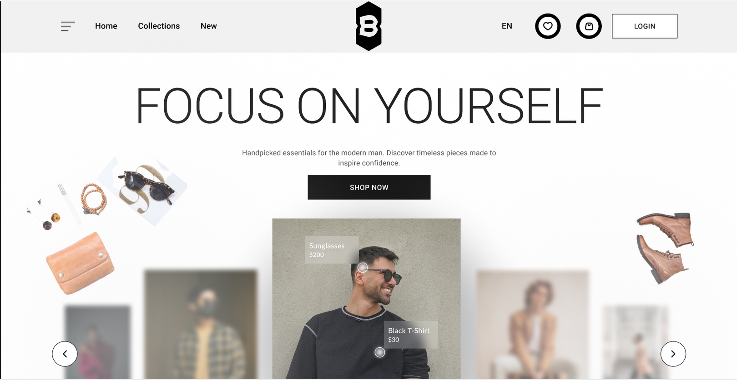
About
Product
Project
Contact
Search
New DESIGN
Page 03
2030

Slide 5
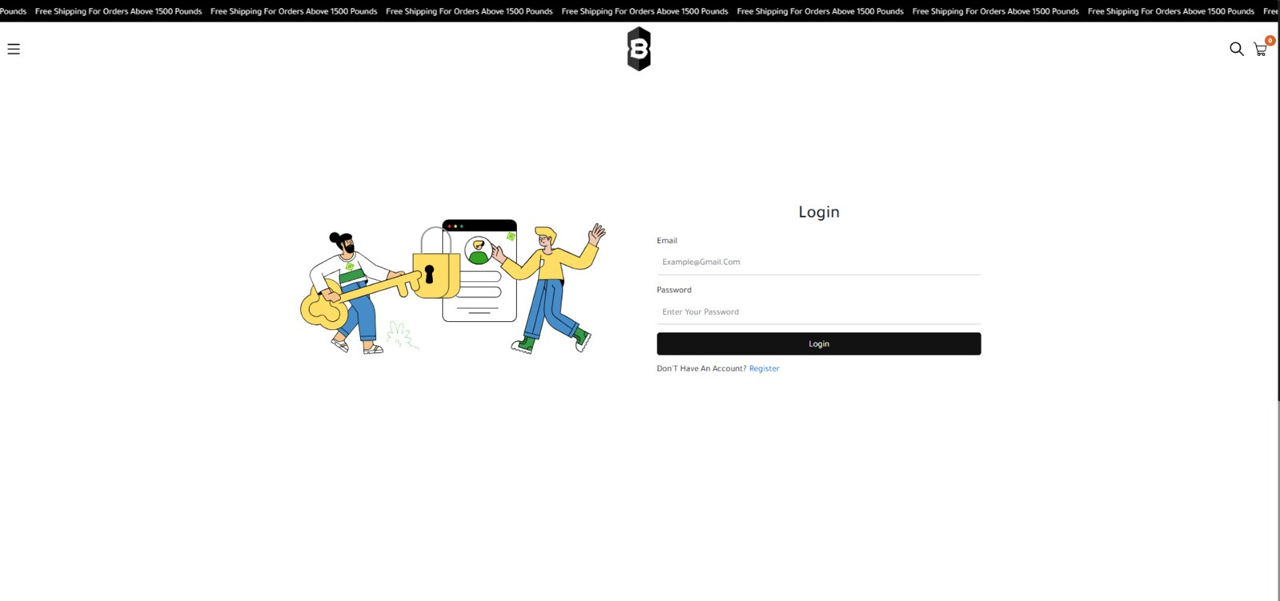
About
Product
Project
Contact
Search
Old DESIGN
Page 03
2030

Slide 6
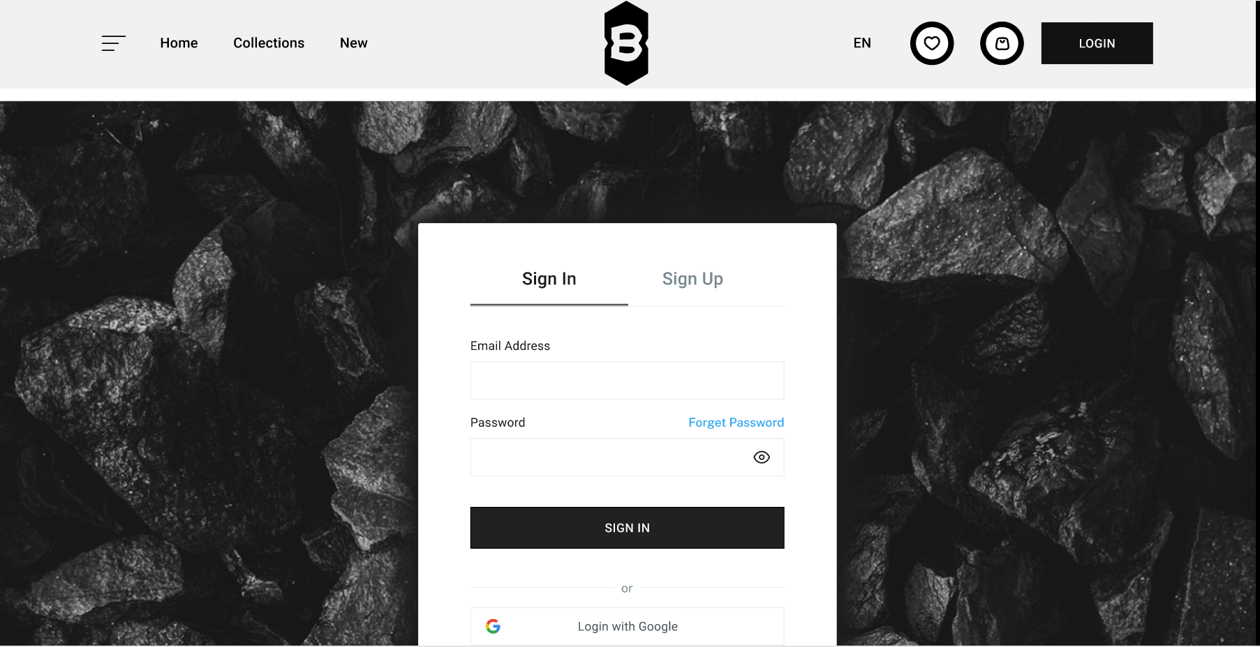
About
Product
Project
Contact
Search
New DESIGN

Slide 7
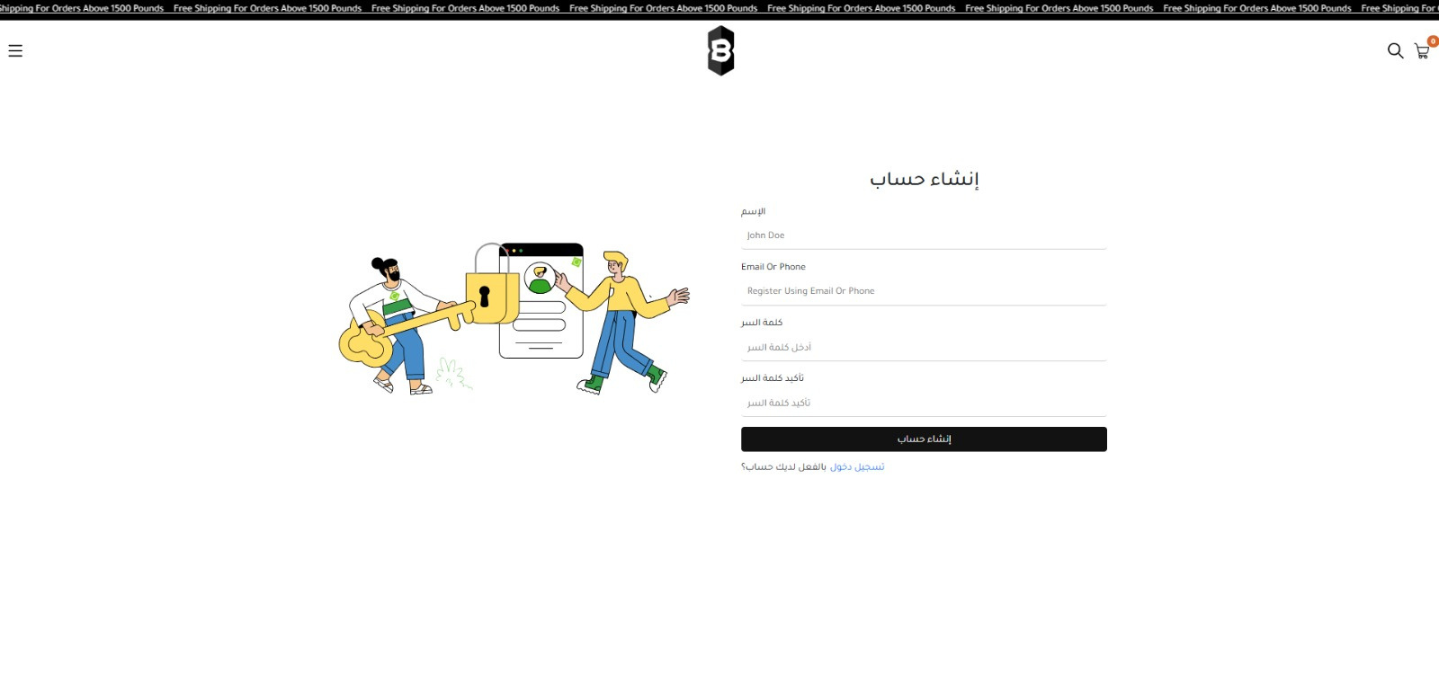
About
Product
Project
Contact
Search
Old DESIGN
Page 03
2030

Slide 8
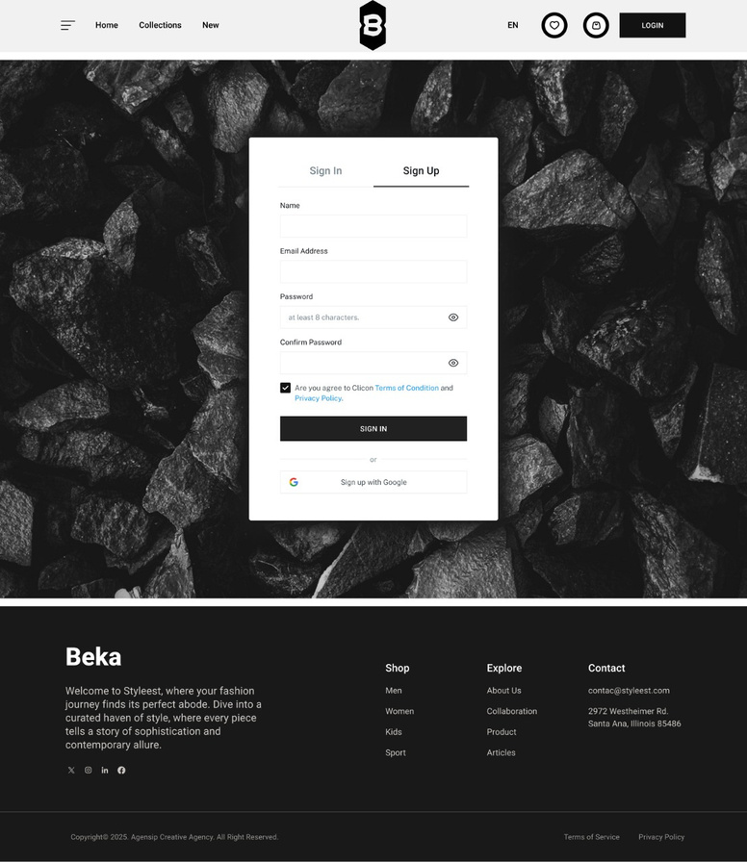
About
Product
Project
Contact
Search
New DESIGN

Slide 9
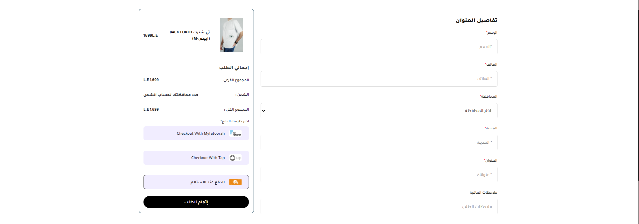
About
Product
Project
Contact
Search
Old DESIGN
Page 03
2030

Slide 10
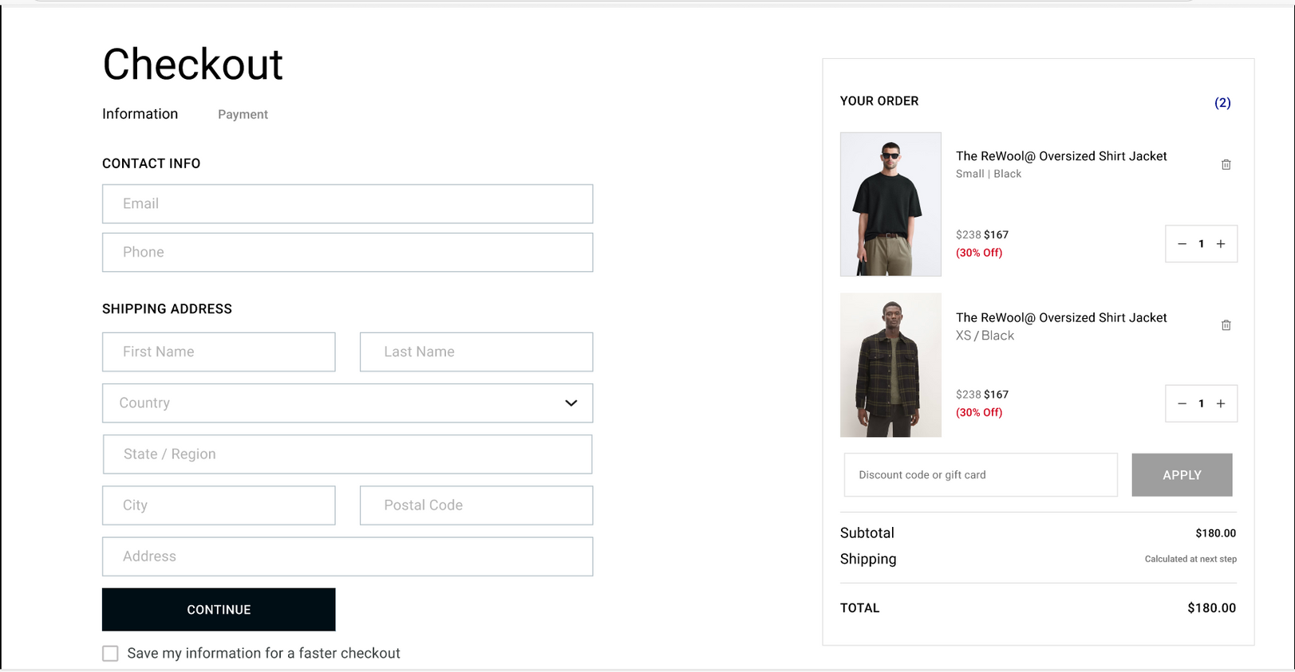
About
Product
Project
Contact
Search
New DESIGN
Page 03
2030

Slide 11
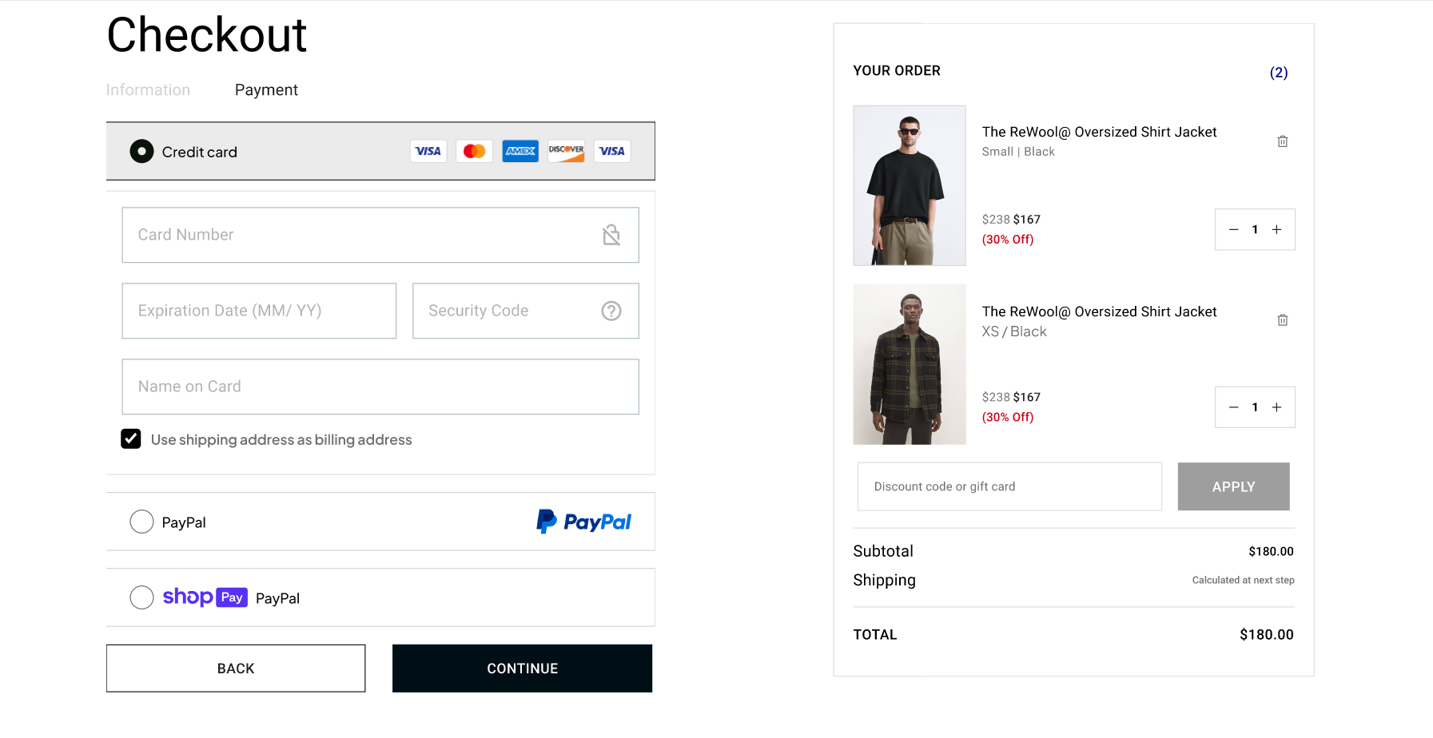
About
Product
Project
Contact
Search
New DESIGN
Page 03
2030

Slide 12
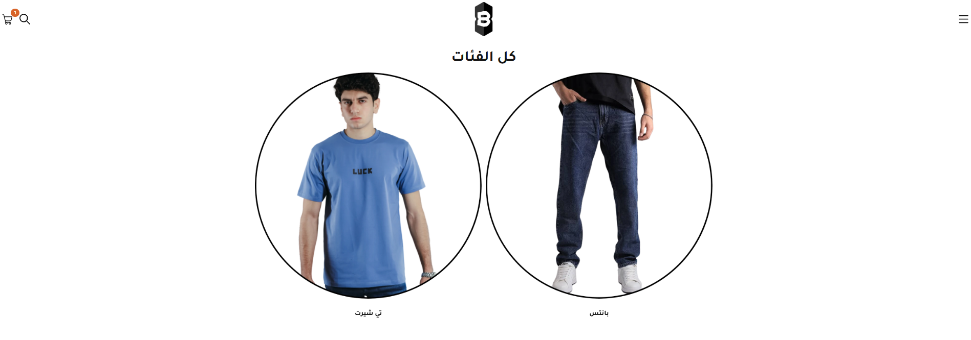
About
Product
Project
Contact
Search
Old Design
Page 03
2030

Slide 13
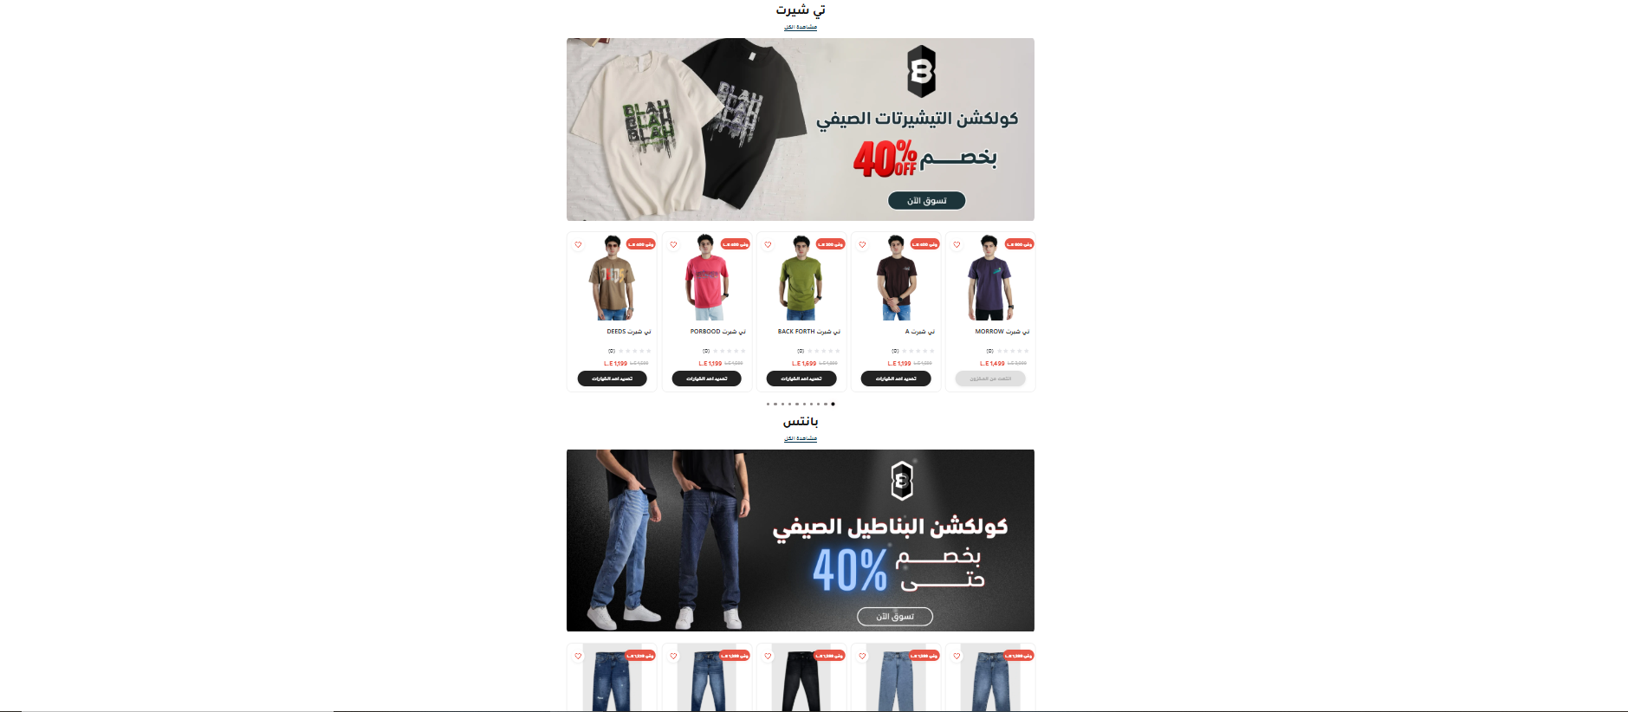
About
Product
Project
Contact
Search
Old Design
Page 03
2030

Slide 14
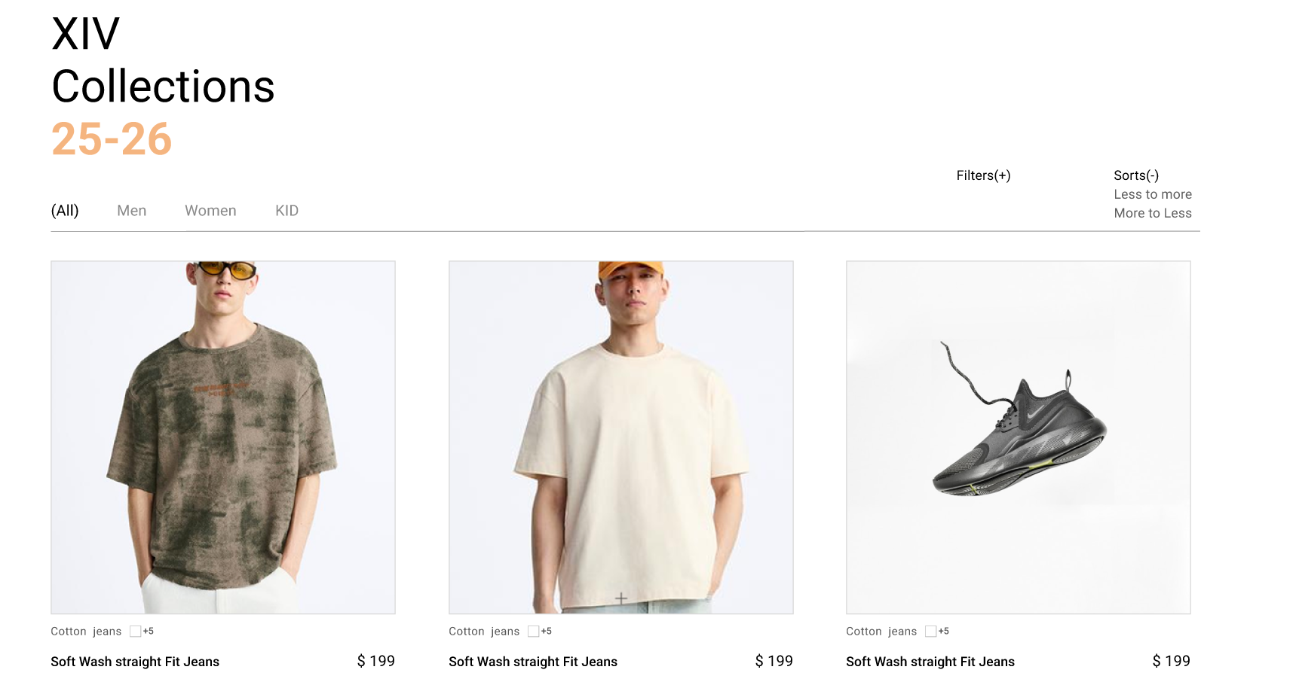
About
Product
Project
Contact
Search
New DESIGN
Page 03
2030

Slide 15
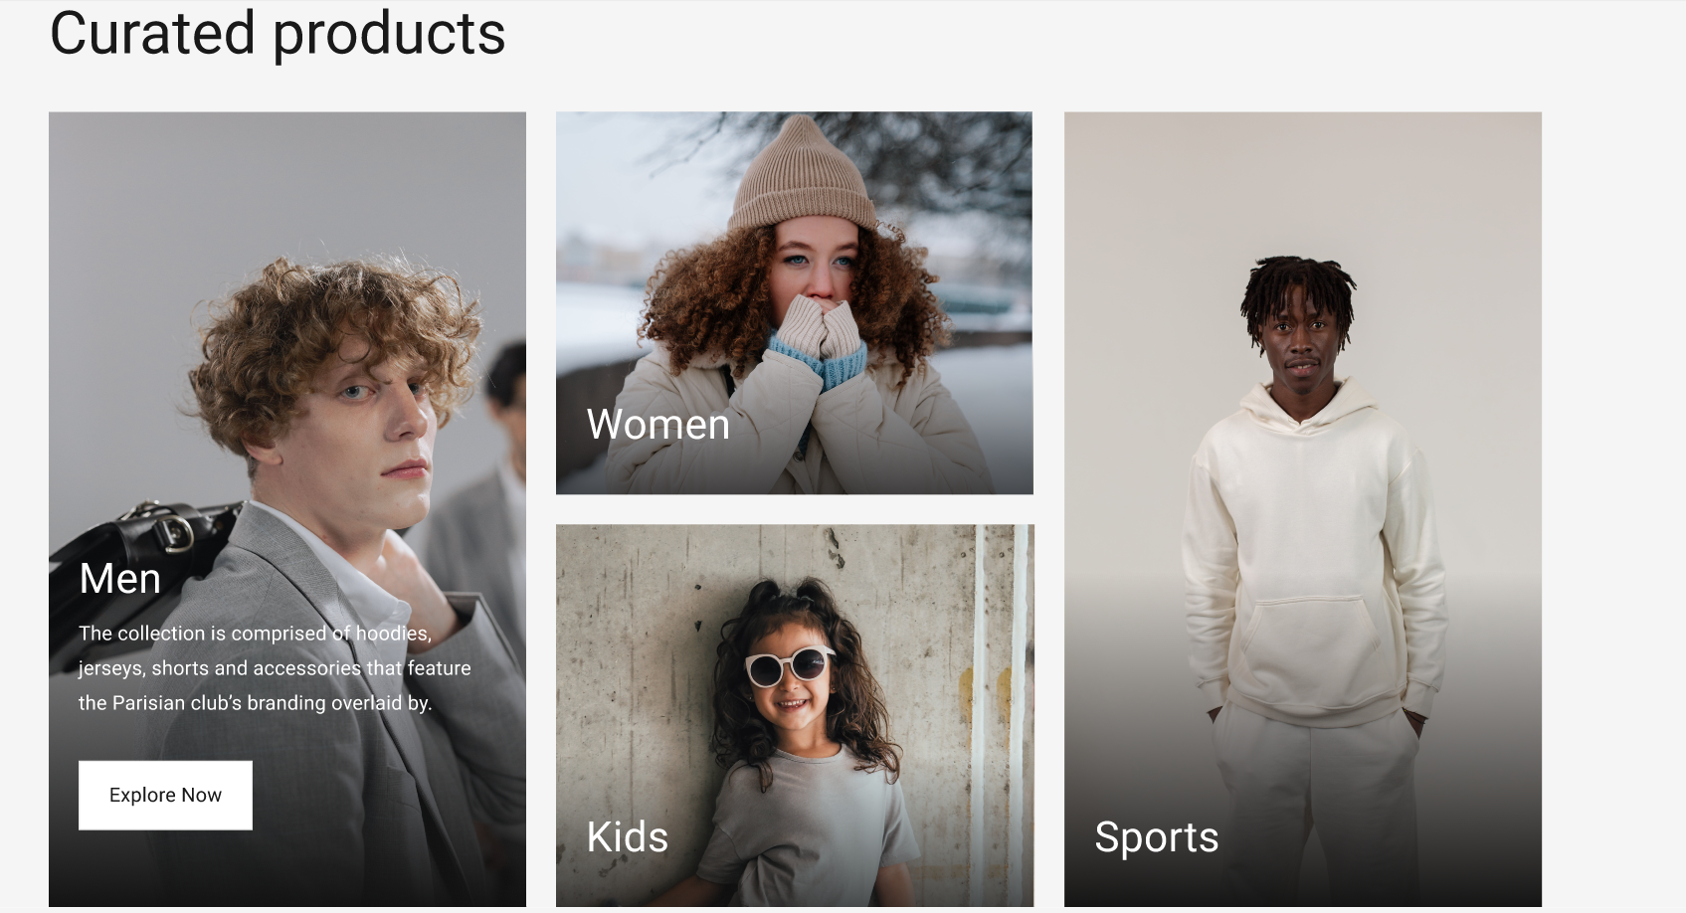
About
Product
Project
Contact
Search
New DESIGN
Page 03
2030

Slide 16
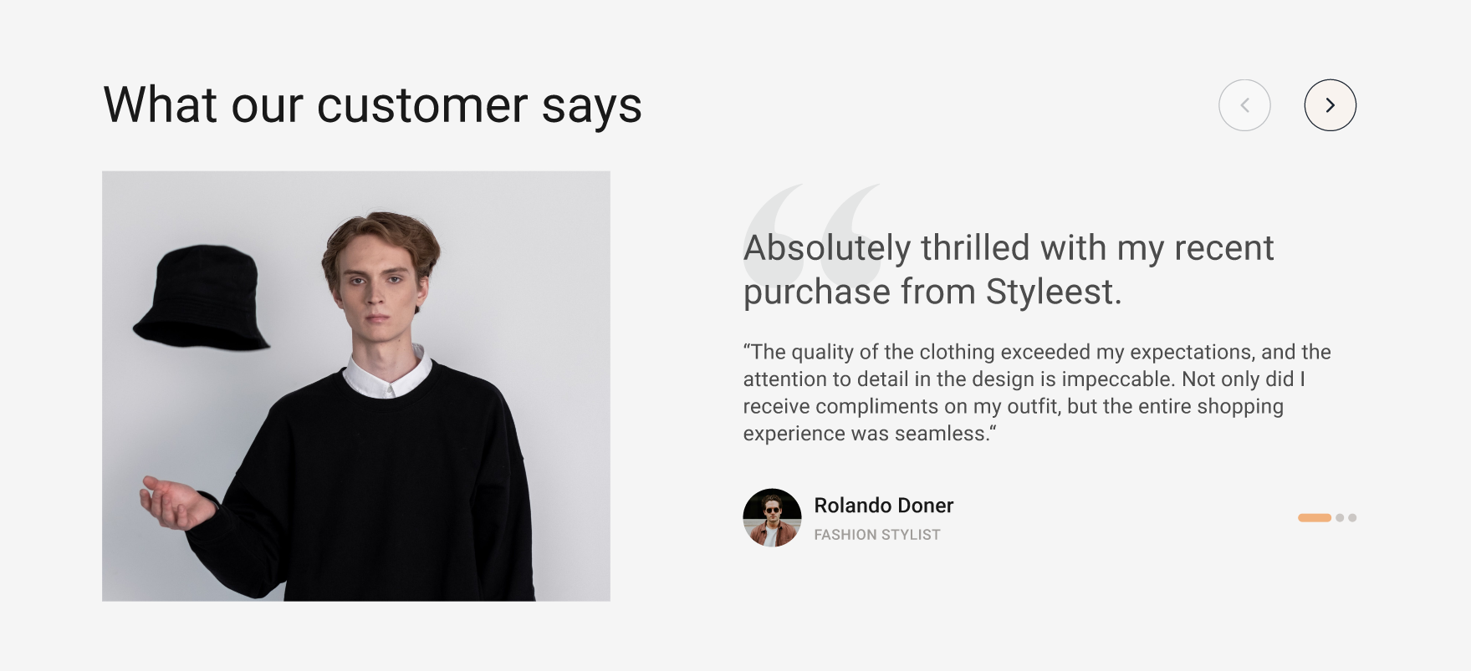
Keithston & Partners
About
Product
Project
Contact
Search
Page 04
2030

Slide 17




Keithston & Partners
About
Product
Project
Contact
Search
THANK YOU
www.reallygreatsite.com
+123-456-7890
123 Anywhere St., Any City

